Slide 1
CSS Prepocessors
by Yurii Holskyi

Slide 2
Why Pre-processing CSS?
CSS is very primitive and incomplete. We can’t building a function, create reusable variables(for now it’s not right), reusable mixins or inheritance, mathematical operations and, etc.
For bigger project maintenance is a big problem.
In order to write a better CSS we have a different approaches, like separating definitions into smaller files and importing them in to one file, but it’s not solving DRY and maintainability problems. Another way it’s object oriented CSS. In this case we applying two or more class definition to an element. Each class – it’s one CSS property. It solve DRY problem but decreased the maintainability.
CSS Pre-processors have some advanced features, which helped to achieve reusable, maintainable and extensible CSS code.

Slide 3

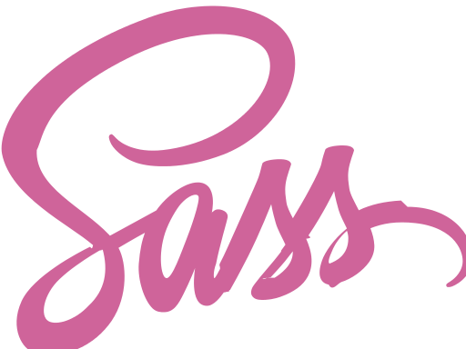

Meet the heroes
Sass(syntactically awesome style sheets) or SCSS(sassy CSS).
It’s the oldest preprocessors, initially released in 2006. Creators Natalie Weizenbaum and Hampton Catlin.
Less(Leaner style sheets) was initially released three years after Sass, in 2009 by Alexis Sellier.
It was influenced by Sass, but later Less also influenced Sass, as the newest SCSS syntax.
The first version of Stylus was launched one year after Less, in 2010 by TJ Holowaychuk.
Stylus is written on Node.js. It was influenced by both Sass and Less.

Slide 4
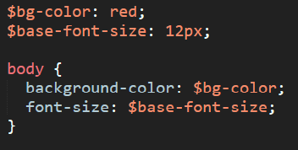
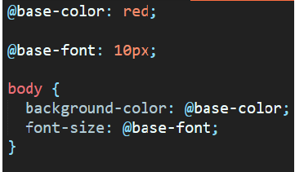
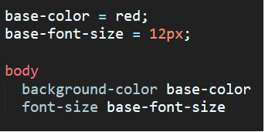
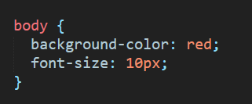
Syntax features (variables) Variables were all time wanted feature in CSS. Every developer want to define a base color, font-size, borders etc.
Sass (.sass or scss extension)
In Sass start with $ sign and assigned by colon.
Compile CSS
Less (.less extension)
In Less start with @ sign and assigned by colon.
Stylus (.styl extension)
In Stylus variables start with name and assigned by equal sign (=).

Slide 5
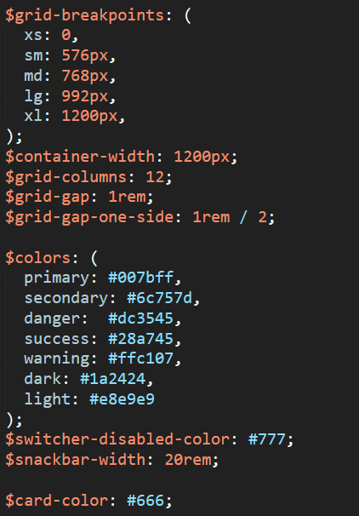
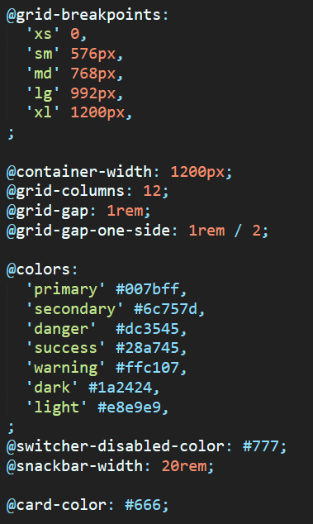
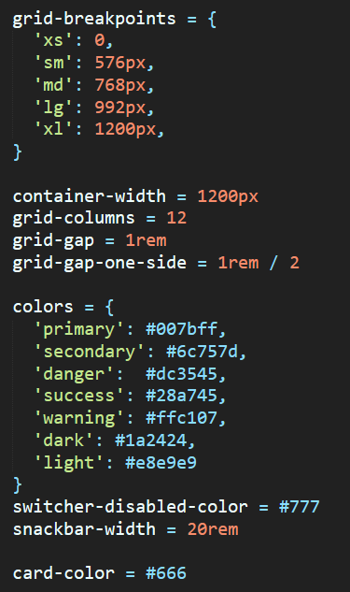
Variables example file

Slide 6
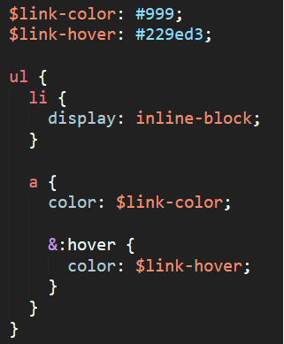
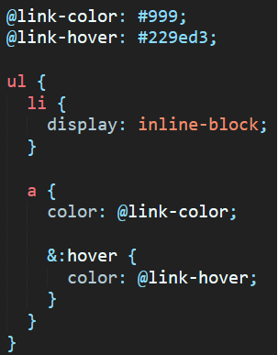
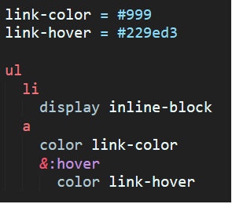
Syntax features (nesting) In CSS you we write selectors and their combinations in separate lines. In Pre-processors we have nesting. Nesting provide a visual hierarchy as in the HTML and then increase readability.
Sass
Less
Stylus

Slide 7
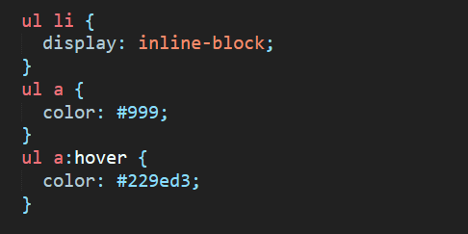
Compile CSS (nesting)

Slide 8
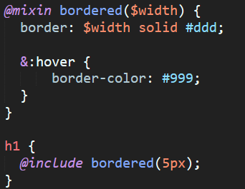
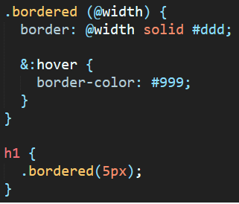
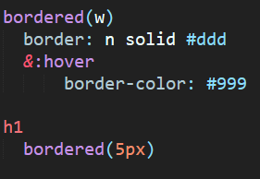
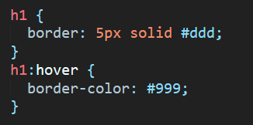
Syntax feature (mixins) Mixins are the set of CSS rules that compiles according to some parameters or static values.
Sass
Compile CSS
Less
Stylus

Slide 9
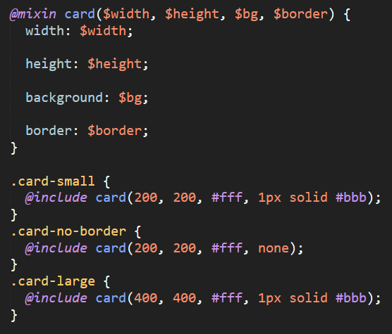
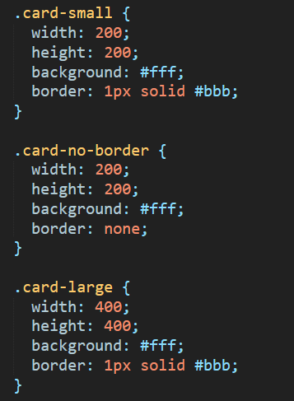
Another example of mixins

Slide 10
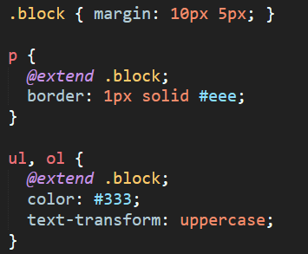
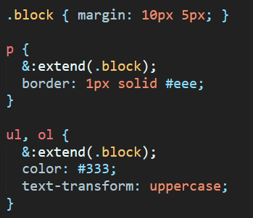
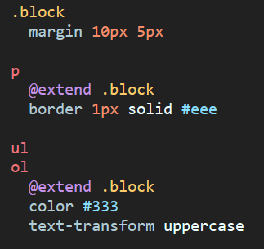
Syntax features (extends) Extends are useful feature for sharing a generic definition with selectors rather than copy in it. It’s like you add another class in your HTML element.
Sass
Less
Stylus

Slide 11
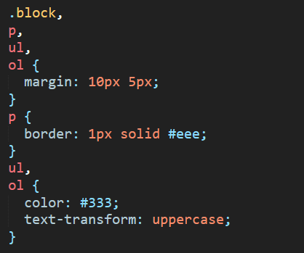
Compile CSS (extends)

Slide 12
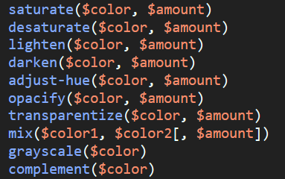
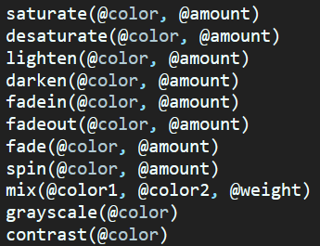
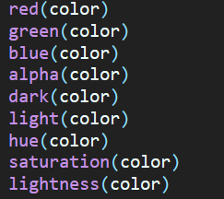
Syntax features (colors interaction) All three pre-processors have color functions to interact with colors. We can lighten the base color or darken it, even mix two or more different colors.
Sass
Less
Stylus

Slide 13
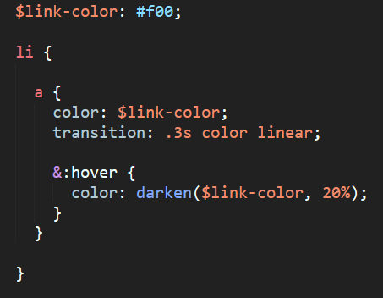
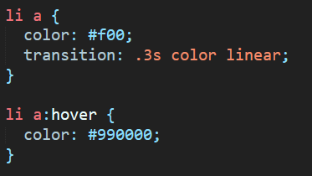
Color operations (example)

Slide 14
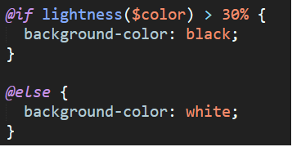
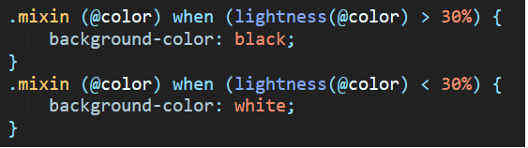
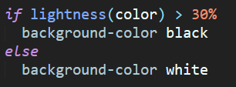
Syntax features (if/else statement) We can control some CSS property according to matching conditions or variables.
Sass
Less
Stylus

Slide 15
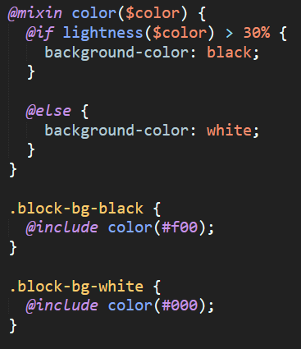
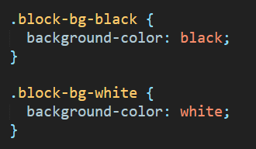
If/Else example

Slide 16
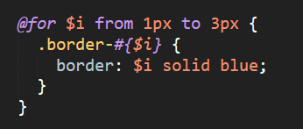
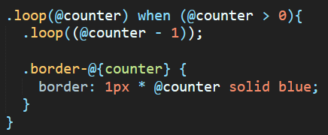
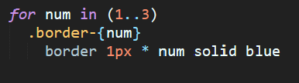
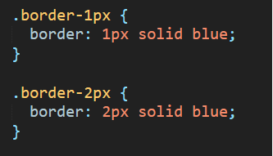
Syntax feature (loops) Loops are useful when we need iterating through an array or create grids, borders, etc.
Sass
Compile CSS
Less
Stylus

Slide 17
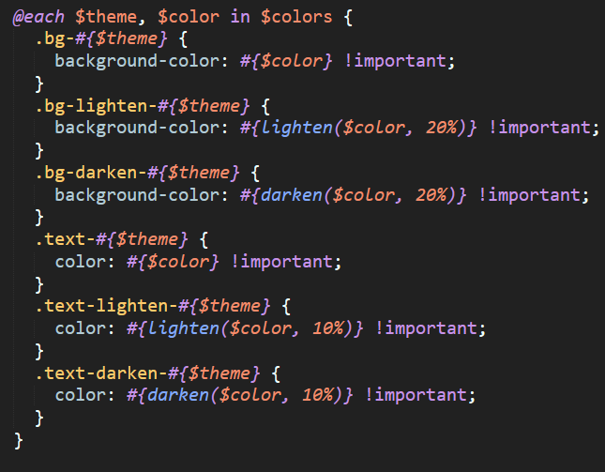
Loop example

Slide 18
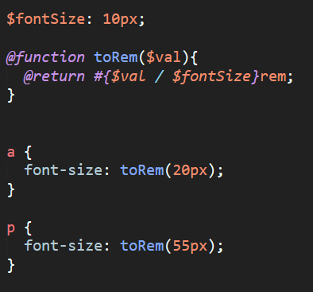
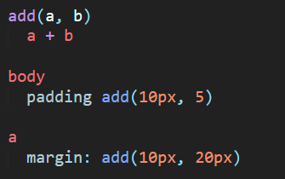
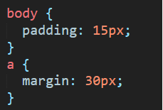
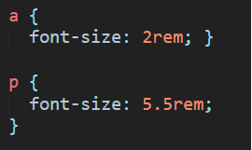
Syntax features (functions) We also can create own functions in Sass and Stylus. Less only have built-in function. (https://github.com/less/less.js/issues/637)
Sass
Nothing here.☹☹☹
Stylus

Slide 19
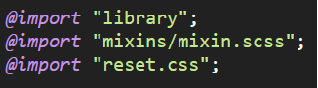
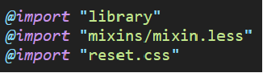
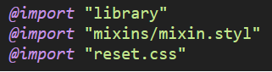
Syntax features (imports) One of the most cool feature. Rather than using a one large file, we can separate our code in small peaces. We can group our variables and create vars.[ext] file, mixins.[ext], etc. and then import them.
Sass
Less
Stylus

Slide 20
It’s end… or not? Another way to write a DRY CSS without pre-processors.

Slide 21
Atomic CSS, or OOP CSS.
For this way we create one CSS class for one rule and then in HTML markup we simply add this classes.
It’s solve the DRY problem but decrease maintainability.
The best example is tailwindcss (https://tailwindcss.com/) – it’s utility-first CSS framework.
Big problem: decrease readability of HTML markup.

Slide 22
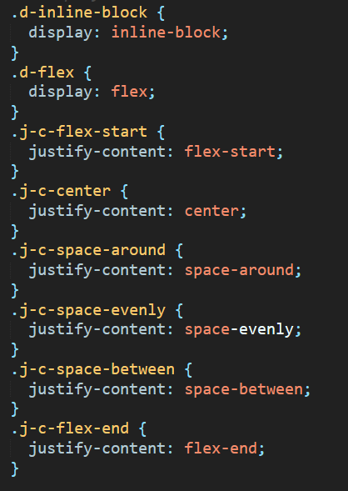
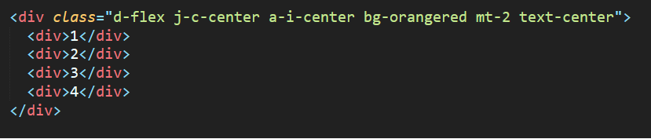
OOP CSS example

Slide 23
Conclusions
In fact, all CSS pre-processors have similar functionality such as variables, mixins, extends, imports, etc. They all follows DRY principles and have a functions, conditional statements and operations.
Sass and Stylus more like programming language, since they allow us to create custom function. Furthemore, Sass has a huge ecosystem and active community. Stylus are very flexible and can be easily integrated in Node project.
Less are also cool for different kind of project where no need write own function or create serious conditional statements.

Slide 24
Sources
https://raygun.com/blog/css-preprocessors-examples/;
http://lesscss.org/;
https://sass-lang.com/;
http://stylus-lang.com/;
https://tailwindcss.com/.

Slide 25
Thank You.

